Slide 1
Serverless - Hackathon
Einführung in Serverless Applications mit Azure Functions, Azure Logic Apps und CosmosDB
Niels Ophey
Cloud Solution Architect

Slide 2
Tagesablauf
09:00 – 10:45 Uhr
Intro und Azure Functions overview – Modul 1
10:45 – 11:00 Uhr
Pause
10:45 – 13:00 Uhr
Cosmos DB overview – Modul 2
13:00– 14:00 Uhr
Mittagspause
14:00 – 15:00 Uhr
Event Grid overview – Modul 3
15:00 – 15:15 Uhr
Pause
15:15 – 16:30 Uhr
Logic Apps overview – Modul 4
16:30 – 17:00 Uhr
Puffer / Abschluß

Slide 3
Vorschlag - Ablauf
28.06.2021
09:30 – 11:00 Uhr
Intro und Azure Functions overview – Modul 1
11:00 – 11:15 Uhr
Pause
11:15 – 12:45 Uhr
Cosmos DB overview – Modul 2
29.06.2021
09:30 – 11:00 Uhr
Event Grid overview – Modul 3
11:00 – 11:15 Uhr
Pause
11:15 – 12:45 Uhr
Logic Apps overview – Modul 4

Slide 4
Why serverless?

Slide 5
History of cloud development
Increasingly advanced cloud technologies have led companies to entrust more and more of their IT activities to service providers
On-premises
IaaS
PaaS
Serverless
Servers & storage
Security
OS & software
Dev tools
Apps & services

Slide 6


What is serverless?
Full abstraction of servers
Developers can just focus on their code—there are no distractions around server management, capacity planning, or availability.
Instant, event-driven scalability
Application components react to events and triggers in near real-time with virtually unlimited scalability; compute resources are used as needed.
Pay-per-use
Only pay for what you use: billing is typically calculated on the number of function calls, code execution time, and memory used.*
*Supporting services, like storage and networking, may be charged separately.

Slide 7

What are the benefits?
Solve business problems—not technology problems related to undifferentiated heavy lifting
Focus
Shorter time to market
Fixed costs converted to variable costs
Better service stability
Better development and testing management
Less waste
Efficiency
Simplified starting experience
Easier pivoting means more flexibility
Easier experimentation
Scale at your pace—don’t bet the farm on Day 1
Natural fit for microservices
Flexibility

Slide 8
What are we building today?

Slide 9
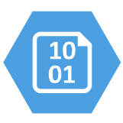






Best For You Organics Company (BFYOC)
Ice cream company on a cloud native journey
1
Serverless API
1
2
Distributed data
GET /products?id={id}
3
Event-driven communication
3
POST /addProducts
4
Serverless orchestration
4
B
CI/CD pipeline
POST /iceCreamOrder
2

Slide 10
Pre-requisites
Azure subscription
Visual Studio or Visual Studio Code
.NET Core 5
NodeJS 14 (LTS) or 16 (Current)
Azure Functions Core Tools v3
HTTP tester like REST Client Extension VSCode
Find all the content at
https://github.com/CSA-OCP-GER/azure-serverless-bootcamp

Slide 11
Build apps faster with Azure Functions

Slide 12
Functions as a Service Concept
Single responsibility
Functions are single-purposed, reusable pieces of code that process an input and return a result
Short lived
Functions don’t stick around when finished executing, freeing up resources for further executions
Stateless
Functions don’t hold any persistent state and don’t rely on the state of any other processes
Event driven & scalable
Functions respond to predefined events, and are instantly replicated as many times as needed

Slide 13
Introducing Azure Functions
Azure Functions as a Service
Use built-in triggers and bindings to define when a function is invoked and to what data it connects
Enhanced development experience
Code, test and debug locally using your preferred editor or the easy-to-use web based interface including monitoring
Hosting options flexibility
Choose the deployment model that better fits your business needs without compromising development experience

Slide 14

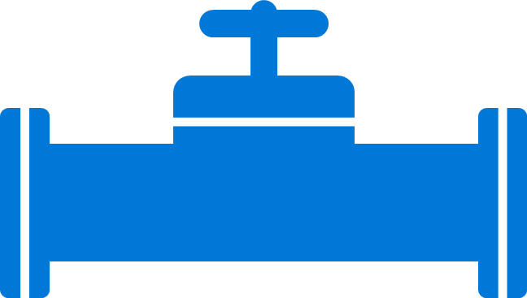
Azure Functions Boost Developer Efficiency
Use triggers to define how functions are invoked
Avoid hardcoding with preconfigured JSON files
Build serverless APIs using HTTP triggers
Connect to data with input and output bindings
Bind to Azure solutions and third-party services
Use HTTP bindings in tandem with HTTP triggers
Triggers
Bindings
Define one API surface for multiple function apps
Create endpoints as reverse proxies to other APIs
Condition proxies to use variables
Debug C# and JavaScript functions locally
Use debugging tools in Azure portal, VS, and VS Code
Proxies
Local debugging
Save time with built-in DevOps
Deploy functions using App Service for CI
Leverage Microsoft, partner services for CD
Integrate with Azure Application Insights
Get near real-time details about function apps
See metrics around failures, executions, etc.
CI/CD
Monitoring
Notes:
Additional information
Triggers and bindings – https://docs.microsoft.com/en-us/azure/azure-functions/functions-triggers-bindings
Monitoring—https://azure.microsoft.com/en-us/services/application-insights/
Local debugging—https://docs.microsoft.com/en-us/azure/azure-functions/functions-run-local#run-functions-locally
CI/CD—https://docs.microsoft.com/en-us/azure/azure-functions/functions-continuous-deployment
Run locally—https://docs.microsoft.com/en-us/azure/azure-functions/functions-run-local
Proxies—https://docs.microsoft.com/en-us/azure/azure-functions/functions-proxies

Slide 15








Azure Functions
Events
Code
Outputs
React to timers, HTTP, or events from your favorite Azure services, with more on the way
Author functions in C#, F#, Node.JS, Java, and more
Send results to an ever-growing collection of services
Notes:
Basic concept of functions – event-driven serverless code in whatever language you like.

Slide 16
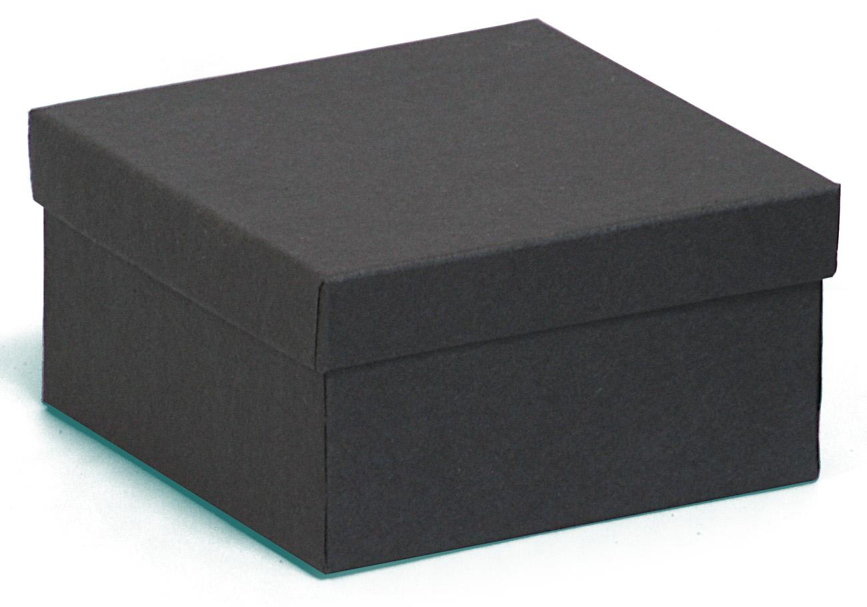
Azure Functions “Behind the scenes”
HTTP Request
HTTP Response

Slide 17
Functions “Behind the scenes”
App Services Infrastructure
Functions Instance
Azure Functions Runtime
HTTP Request
Azure Functions (App Services) HTTP Front-end
Functions Instance
HTTP Response
Azure Functions Runtime
Scale Controller
Functions Instance
Azure Functions Runtime

Slide 18






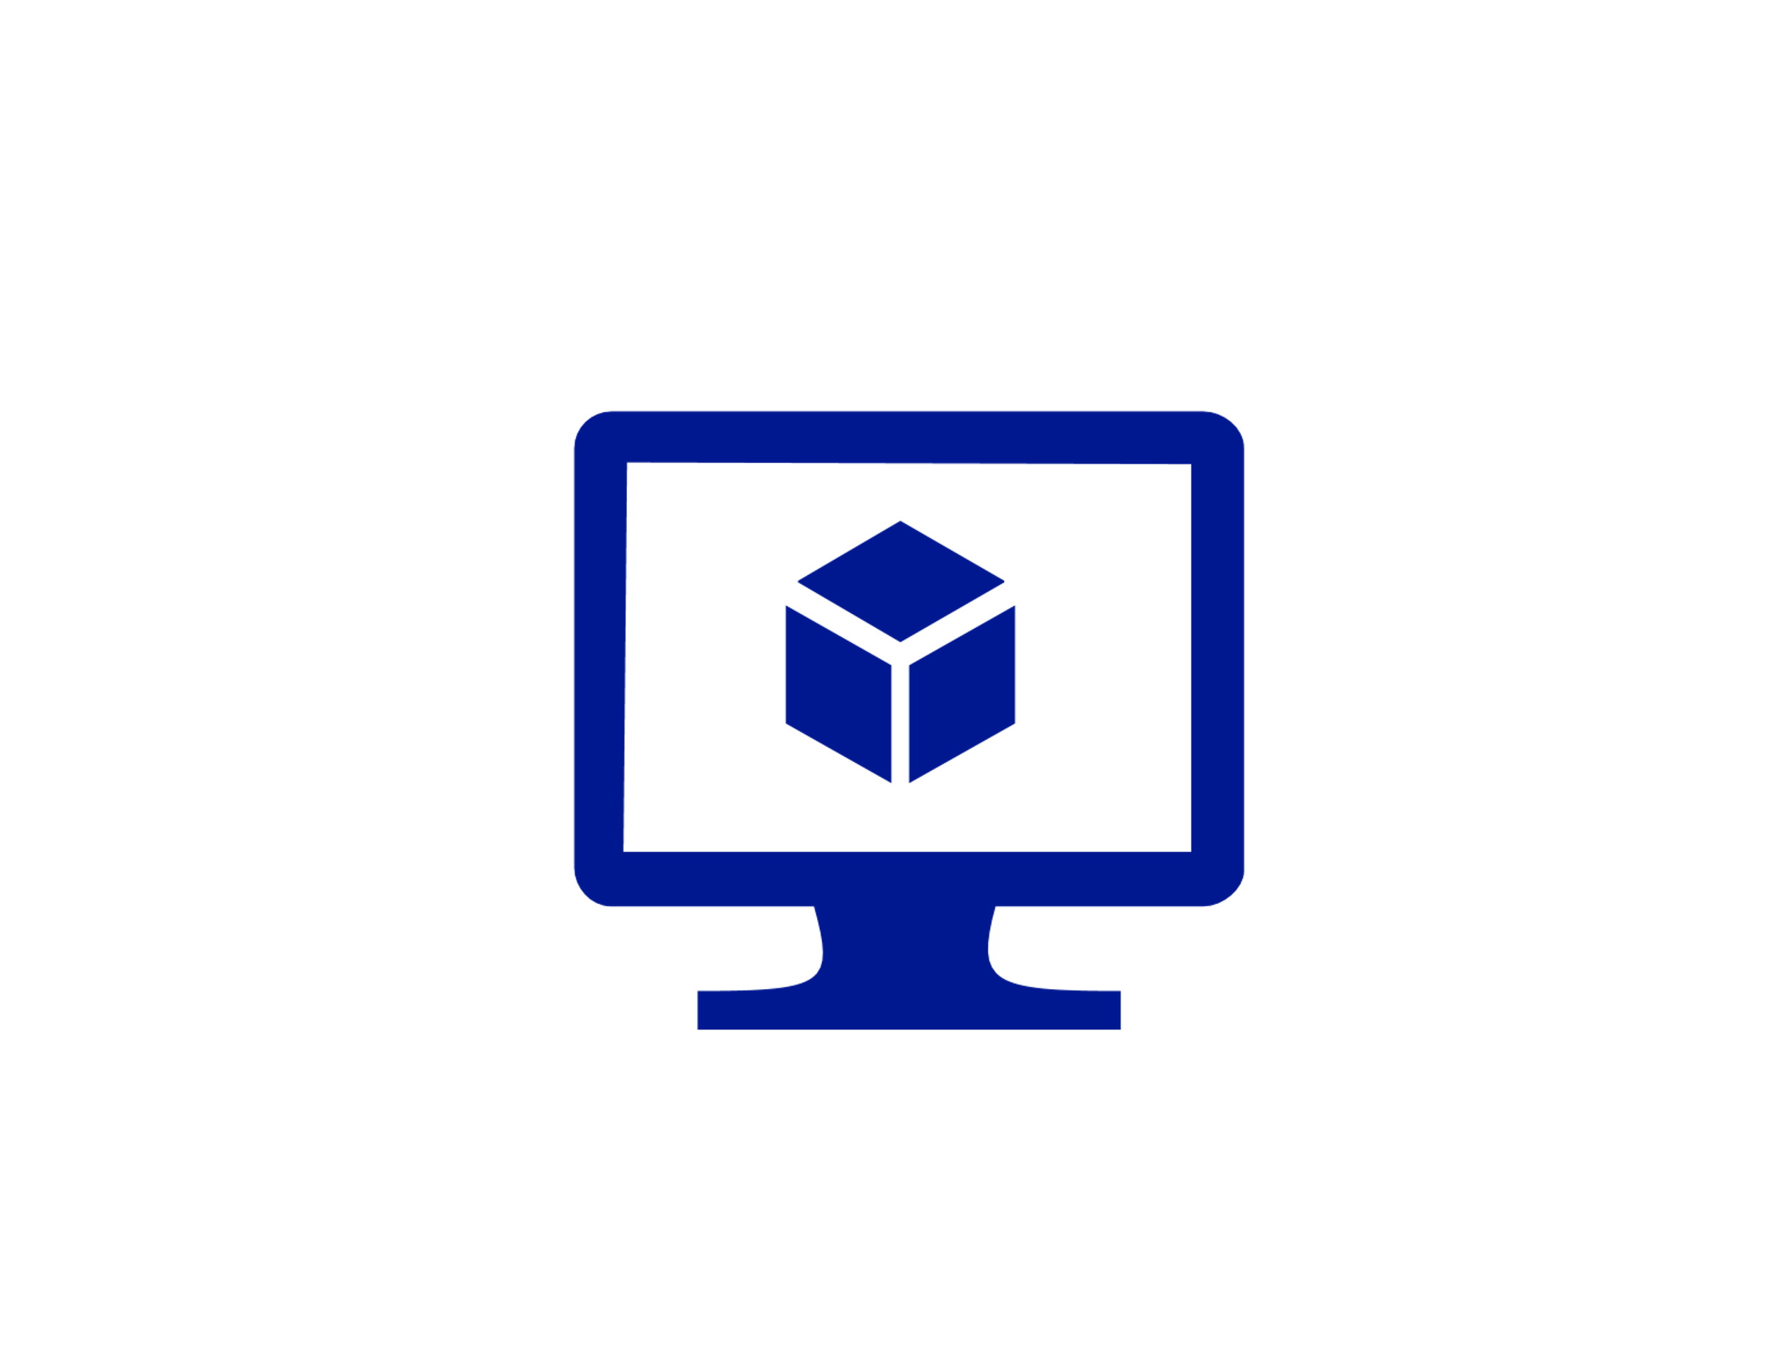

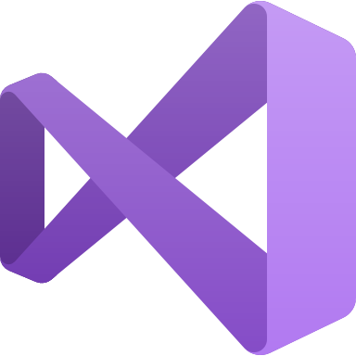

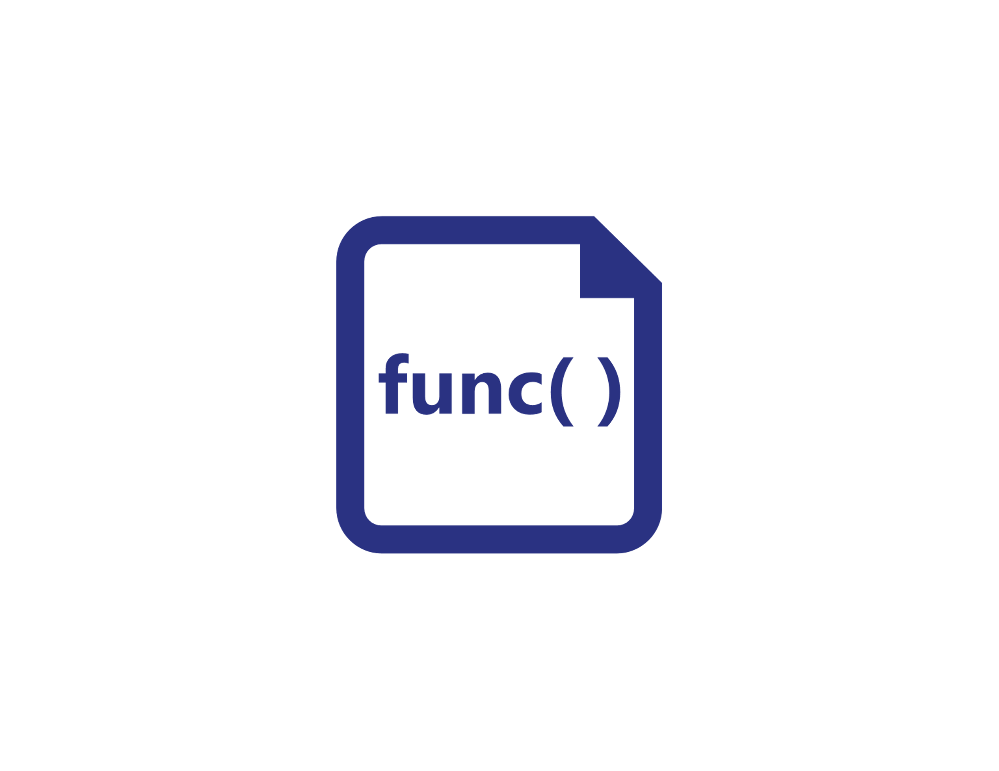




Azure Functions Hosting Options
Azure Functions host runtime
Azure Functions Core Tools
Azure Functions base Docker image
Azure Functions .NET Docker image
Azure Functions Node Docker image
●●●
Development
Hosting
Local dev machine
Azure Functions
service
Azure Functions
service
Azure Functions service
IoT devices
Additional Azure hosts
Non-Azure hosts / on-premises
Non-Azure hosts / on-premises
Platform
+
●●●
●●●
●●●
Core Tools + favorite editor
Consumption plan
Premium plan
App Service plan
Azure IoT Edge
AKS, Service Fabric, …
K8s, raw VMs, & more
App Service on Azure Stack
Application delivery
Code or container
Code
Code or container
Code or container
Container
Container
Container
Code
Operating system
Windows, macOS, or Linux
Windows or Linux
Windows or Linux
Windows or Linux
Linux
Linux
Linux
Windows

Slide 19

Azure Functions Triggers & Bindings
Blob Storage
Cosmos DB
Event Hub
HTTP
Queues
Service Bus
Timer
Webhook
TRIGGERS are what cause a function to run. A trigger defines how a function is invoked and a function must have exactly one trigger. Triggers have associated data, which is often provided as the payload of the function.
BINDING to a function is a way of declaratively connecting another resource to the function; bindings may be connected as input bindings, output bindings, or both. Data from bindings is provided to the function as parameters..

Slide 20
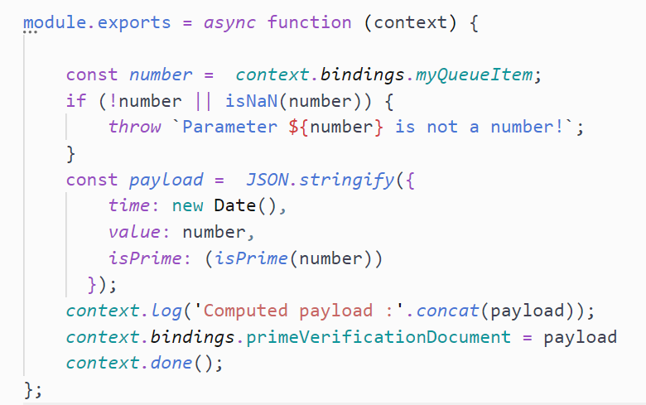
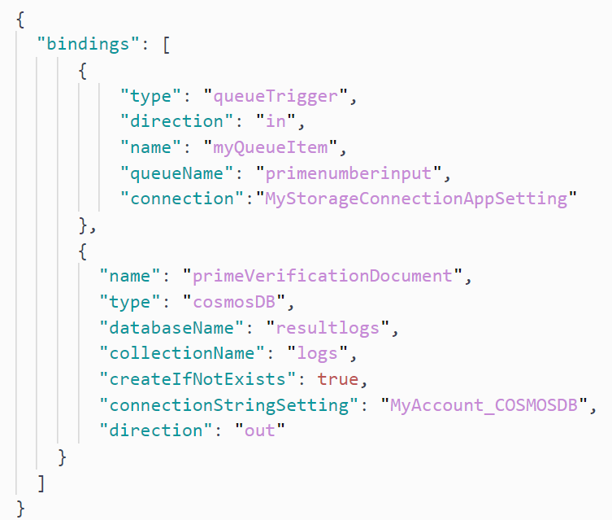
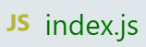
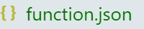
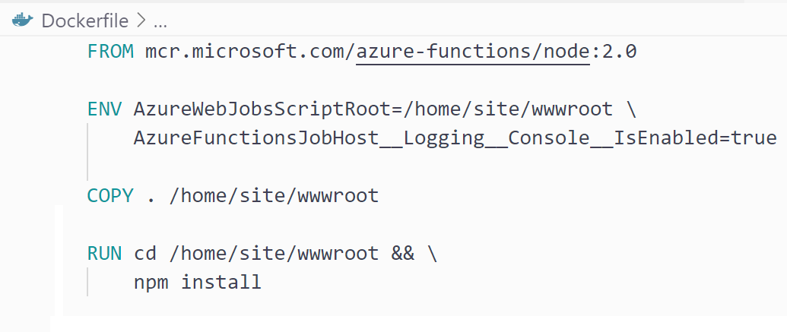


Azure Functions Bindings Example

Slide 21




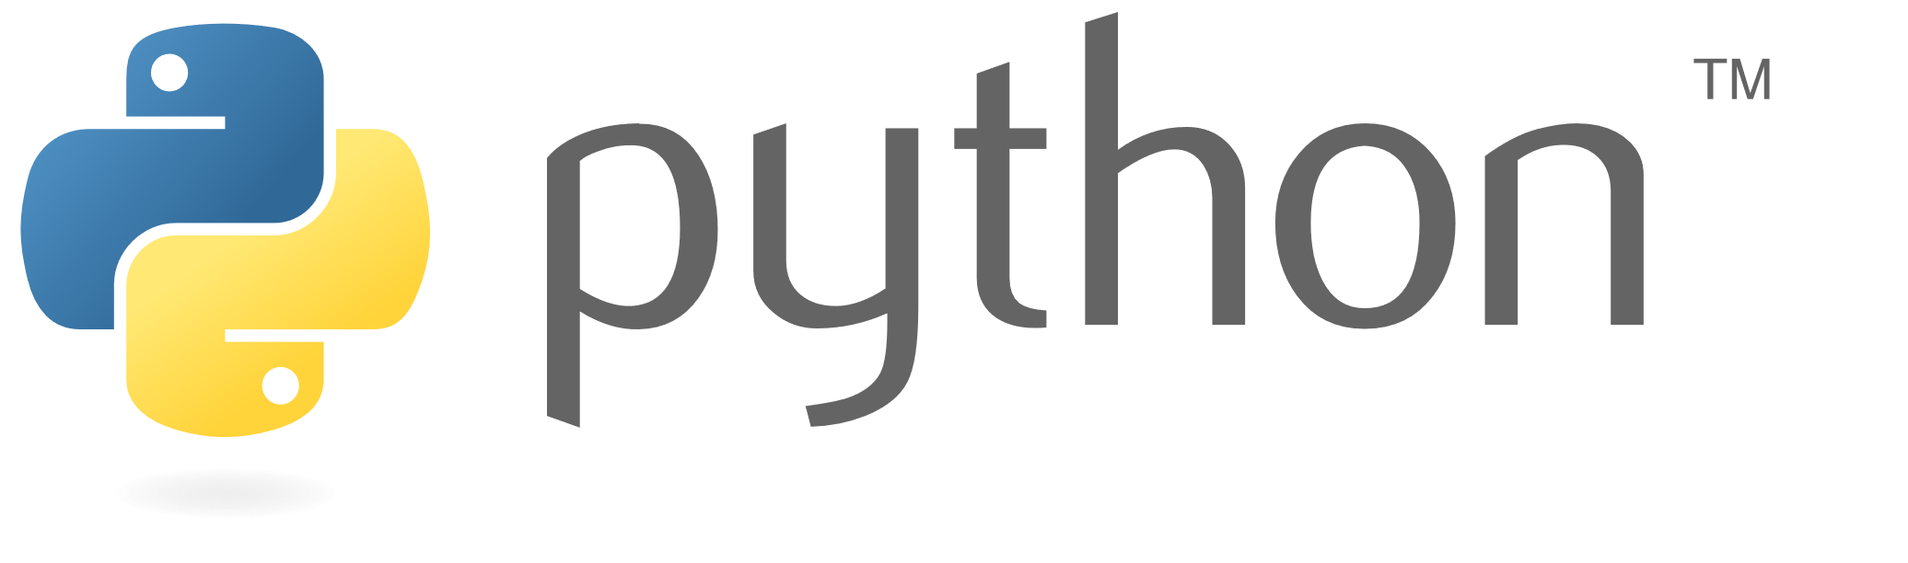
Azure Functions Language Support

Slide 22
Azure Functions Language Support
Language | 1.x | 2.x | 3.x
C# | GA (.NET Framework 4.7) | GA (.NET Core 2.2¹) | GA (.NET Core 3.1) Preview (.NET 5.0)
JavaScript | GA (Node 6) | GA (Node 10 & 8) | GA (Node 14, 12, & 10)
F# | GA (.NET Framework 4.7) | GA (.NET Core 2.2¹) | GA (.NET Core 3.1)
Java | N/A | GA (Java 8) | GA (Java 11 & 8)
PowerShell | N/A | GA (PowerShell Core 6) | GA (PowerShell 7 & Core 6)
Python | N/A | GA (Python 3.7 & 3.6) | GA (Python 3.8, 3.7, & 3.6) Preview (Python 3.9)
TypeScript | N/A | GA² | GA²
¹ .NET class library apps targeting runtime version 2.x may now be run on .NET Core 3.1 in .NET Core 2.x compatibility mode.
² Supported through transpiling to JavaScript.

Slide 23
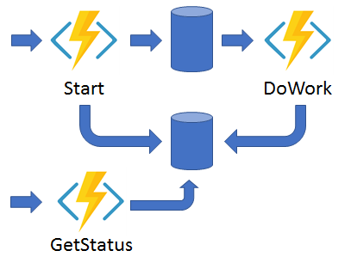
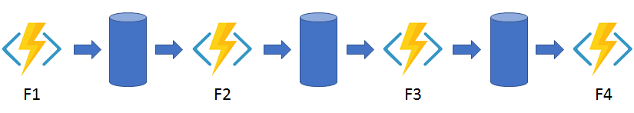
Introducing Durable Functions
Durable Functions: an extension of Azure Functions that lets you write stateful functions in a serverless compute environment.
The extension lets you define stateful workflows by writing orchestrator functions and stateful entities by writing entity functions using the Azure Functions programming model.
Behind the scenes, the extension manages state, checkpoints, and restarts for you, allowing you to focus on your business logic.

Slide 24
Other Options for Background Tasks
Azure Web Apps and WebJobs. You can use WebJobs to execute custom jobs based on a range of different types of scripts or executable programs within the context of a web app.
Azure Virtual Machines. If you have a Windows service or want to use the Windows Task Scheduler, it is common to host your background tasks within a dedicated virtual machine.
Azure Batch. Batch is a platform service that schedules compute-intensive work to run on a managed collection of virtual machines. It can automatically scale compute resources.
Azure Kubernetes Service (AKS). Azure Kubernetes Service provides a managed hosting environment for Kubernetes on Azure.

Slide 25
Functions as Microservices
Each microservice operation could map to a Function
Fine-grained tuning, scaling and permissions per function
Optional Function Proxy
Simplified API Gateway
Exposes single API surface to abstract multiple backend function operations
Product Catalog
Get/product/id
Get Product
Function Proxy
(API Gateway)
Shopping Basket
Post/basket/item
Web user
Add Item
Shopping Basket
Post/basket/checkout
Check Out

Slide 26
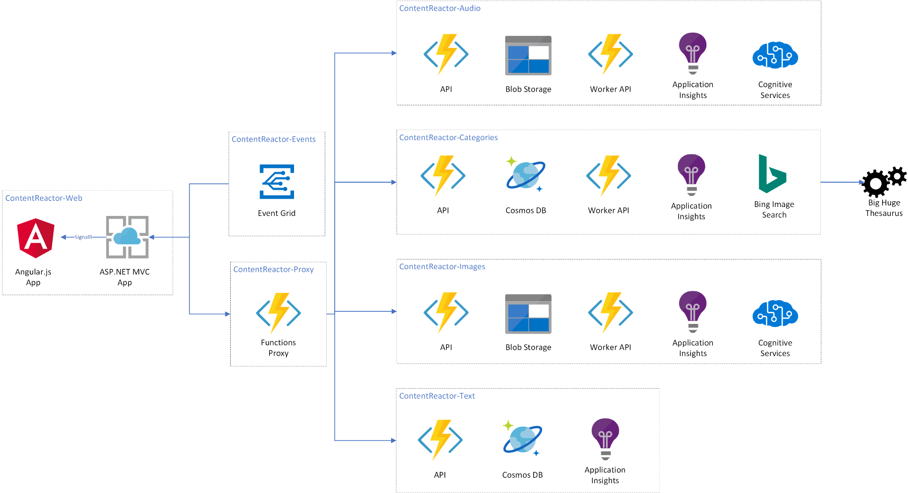
Serverless App High Level Example

Slide 27

Cold start controls
Hosting options

Slide 28
Your app in ✨concept✨

Slide 29
Your app with long cold start

Slide 30
Your app with one pre-warmed instance

Slide 31

Azure Functions Increase Flexibility
Write code in C#, JavaScript, F#, and Java
Continuous investment in new, experimental languages
Write stateful functions in a serverless environment
Simplify complex, stateful coordination problems
Add the extension to enable advanced scenarios
Multiple languages
Durable Functions
Choose from six consumption plans to run Functions
Run your first million function executions for free
Simplify coding for new users with native Azure portal
Select from popular editors, like VS, VS Code, CLI, Maven*
Hosting options
Dev options
*VS and VS Code only support C#; Maven only supports Java
Notes:
Additional information
Triggers and bindings – https://docs.microsoft.com/en-us/azure/azure-functions/functions-triggers-bindings
Monitoring—https://azure.microsoft.com/en-us/services/application-insights/
Local debugging—https://docs.microsoft.com/en-us/azure/azure-functions/functions-run-local#run-functions-locally
CI/CD—https://docs.microsoft.com/en-us/azure/azure-functions/functions-continuous-deployment
Run locally—https://docs.microsoft.com/en-us/azure/azure-functions/functions-run-local
Proxies—https://docs.microsoft.com/en-us/azure/azure-functions/functions-proxies

Slide 32


var outputs = new List<string>();
outputs.Add(await context.CallActivityAsync<string>("SayHello", “Amsterdam"));
return outputs;
Orchestrator Function
Orchestrator Function
Activity Function
Orchestrator Started
Activity Function
Execution Started
Task Scheduled, SayHello, “Amsterdam”
Orchestrator Completed
[“Hello Amsterdam!”]
“Hello Amsterdam!”
“Hello Amsterdam!”
Task Completed, “Hello Amsterdam!”
?
Orchestrator Started
Execution Completed, ["Hello Amsterdam!"]
Orchestrator Completed
Execution History
Notes:
Grasping how orchestrators use execution history to replay and rebuild their local state is key to understanding how Durable Functions works, so let’s walk through the execution of a simple orchestrator function.
The light blue box at the top of the slide is the orchestrator’s code.
“SayHello” our activity function, which returns “Hello” and whatever input you give it.
Our execution history is currently empty. As we start to record events, they’ll show up here. (Indicate area.)
1. A request is made to the orchestrator function.
2. The orchestrator starts and begins executing until it’s asked to await some async work. In this case, we want to call an activity function.
3. The orchestrator checks the execution history for a record of the activity function.
4. There’s no record of the activity function being called or completed, so the orchestrator schedules that work.
5. While the orchestrator waits on work to complete, it shuts down.
5. The scheduled activity function runs.
6. A record of this is added to the execution history. In this case we produced output, so that’s stored.
7. Now the orchestrator has more work to do. It restarts and executes its code **from the beginning** to build up its local state.
8. As before, the orchestrator executes until it reaches an await.
9. The orchestrator checks the execution history. This time there’s a record of the async work being done.
10. The activity function’s stored output is passed back to the orchestrator. In this case, the value is added to a list of strings.
11. The orchestrator continues executing. In a more complex orchestrator with multiple await calls, the checkpoint, schedule and replay steps would repeat for each one. This orchestrator runs to completion and returns its output.
12. And we’re done!
- How does the framework know to wake up

Slide 33
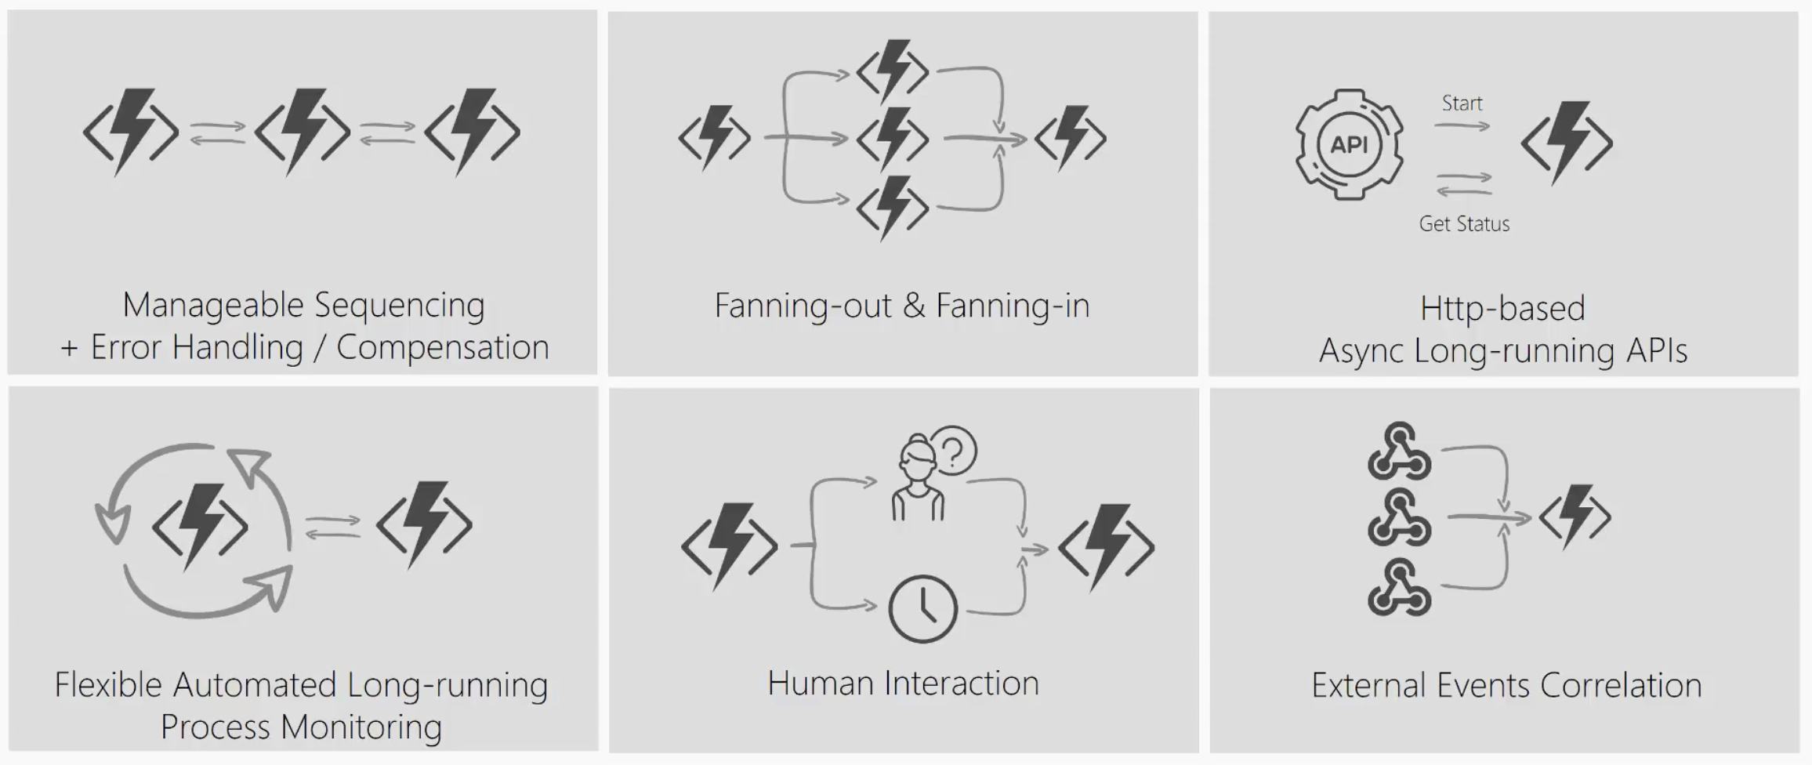
Durable Functions Patterns
Durable Functions
Notes:
Imagine a scenario where I have to take the output of a Function and use it as the input to call another Function. I’ll have to coordinate the chaining manually.
If I have to have a function that takes some sort of event and then parallelizes it into multiple Functions, I can still do that but how will I know when all Functions have finished executing so I can aggregate the results and move on.
What if I had to listen on multiple events and aggregate their outcome to determine which specific job or function to run in my application.
What if I wanted to do some kind of extended monitoring on an endpoint? For example, if I were to monitor the temperature of a remote machine and take action x if the temperature were lower than a certain threshold, else do y or run job y.
What if I have an API or endpoint that was running for a long time? I know Functions are short-lived but sometimes you guys put some serious load on them. Could there be a mechanism to provide status of the execution back to the client so they’re not left hanging?
And lastly, what if I wanted to get some sort of human interaction in there? For example, if I am to do some sort of 2FA in the middle of my function execution but also don’t want to wait forever because sometimes people take forever to reply especially when the texts are automated.
Today, I’m going to be talking about some of these problems – how you can approach them in regular FaaS? And how they can be simplified with the technology of Durable Functions.

Slide 34




Web application backends
Scenario Example
Retail
Online orders are picked up from a queue, processed and the resulting data is stored in a database.
Request made in a web app
Request queued in Service Bus
A function processes the request…
…sends output to Cosmos DB

Slide 35


Mobile application backends
Scenario Example
Financial Services
Colleagues use mobile banking to reimburse each other for lunch: the person who paid for lunch requests payment through his mobile app, triggering a notification on his colleagues’ phones.
HTTP API call from a mobile app
Call processed by a function
Output data stored in Cosmos DB
Data transfer triggers second function…
…which sends notifications using Notifications Hub

Slide 36


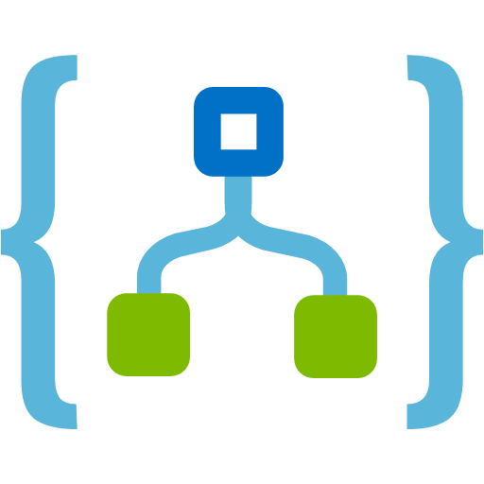


IoT-connected backends
Connected IoT devices producing data
Scenario Example
Manufacturing
Data sent to IoT Hub
A manufacturing company uses IoT to monitor its machines. Functions detects anomalous data and triggers a message to Service department when repair is required.
Data with special condition routed to a function
A function processes message...
…and calls Logic Apps
…which invokes Zendesk…
…to request device repair

Slide 37

Conversational bot processing
Scenario Example
Hospitality
Customer asks for available vacation accommodations on her smartphone. A serverless bot deciphers the request and returns vacation options.
?
?
?
User request through conversational interface
Bot running in a function deciphers request using language understanding
Another function processes the request
…and sends response to original requester

Slide 38

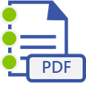


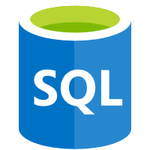

Real-time file processing
Scenario Example
Healthcare
Patient records are securely uploaded as PDF files. That data is then decomposed, processed using OCR detection, and added to a database for easy queries.
PDF file added to Blob Storage
A function decomposes PDF file…
…and sends it to Cognitive Services for OCR detection
Structured data from file sent to SQL DB

Slide 39


Real-time stream processing
App or device producing data
Scenario Example
ISV
Huge amounts of telemetry data is collected from a massive cloud app. That data is processed in near real-time and stored in a DB for use in an analytics dashboard.
Event Hubs ingests telemetry data
A function processes the data…
…and sends it to Cosmos DB
Data used for dashboard visualizations

Slide 40

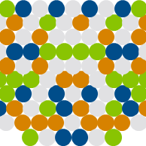
Automation of scheduled tasks
Scenario Example
Financial Services
A customer database is analyzed for duplicate entries every 15 minutes, to avoid multiple communications being sent out to same customers.
A function cleans a database every 15 minutes…
…deduplicating entries based on business logic

Slide 41




Extending SaaS applications
Scenario Example
Professional Services
A SaaS solution provides extensibility through webhooks, which can be implemented through Functions, to automate certain workflows.
Issue created in GitHub…
…which triggers a webhook call
…which is processed by a function…
…by posting the issue details to Slack

Slide 42


What makes Functions unique?
Feature variety
Flexible run options
A host of features, from bindings to code editors, gives you the tools needed to quickly create the best apps
Durable Functions
With so many plan options, you can choose the level of access that’s best for your company and customers
With this extension Azure Functions help you simplify complex, stateful orchestration problems
Intuitive experience
Consolidated tools
Easy-to-use, familiar tools like the Azure portal and Visual Studio help you get running on serverless fast
Thanks to so many built-in solutions, you can do more in Functions than AWS, which often requires external tools

Slide 43

Azure Functions is an open-source project Functions runtime and all extensions are fully open source
https://github.com/Azure/Azure-Functions

Slide 44








Full integration with Azure ecosystem Functions is the center piece of the Serverless platform
Development
Platform
IDE support
Event Grid
Functions
Logic Apps
Manage all events that can trigger code or logic
Execute your code based on events you specify
Design workflows and orchestrate processes
Integrated DevOps
Local development
Monitoring
Database
Storage
Analytics
Intelligence
Security
IoT
Visual debug history

Slide 45
Module 1 – Serverless API
Instructions at
https://github.com/CSA-OCP-GER/azure-serverless-bootcamp

Slide 46
Cosmos DB

Slide 47
Turnkey global distribution
PUT YOUR DATA WHERE YOUR USERS ARE IN MINUTES
Automatically replicate all your data around the world, and across more regions than AWS and Google Cloud Platform combined.
Available in all Azure regions
Manual and automatic failover
Automatic & synchronous multi-region replication

Slide 48
ELASTIC SCALE OUT OF STORAGE AND THROUGHPUT
SCALES AS YOUR APPS’ NEEDS CHANGE
Independently and elastically scale storage and throughput across regions – even during unpredictable traffic bursts – with a database that adapts to your app’s needs.
Elastically scale throughput from 10 to 100s of millions of requests/sec across multiple regions
Support for requests/sec for different workloads
Pay only for the throughput and storage you need

Slide 49
GUARANTEED LOW LATENCY
PROVIDE USERS AROUND THE WORLD WITH FAST ACCESS TO DATA
Serve <10 millisecond read and write requests at the 99th percentile from the region nearest to users, while delivering data globally.

Slide 50
FIVE WELL-DEFINED CONSISTENCY MODELS
CHOOSE THE BEST CONSISTENCY MODEL FOR YOUR APP
Offers five consistency models
Provides control over performance-consistency tradeoffs, backed by comprehensive SLAs.
An intuitive programming model offering low latency and high availability for your planet-scale app.
Strong
Bounded-stateless
Session
Consistent prefix
Eventual

Slide 51


Multiple data models and apis
USE THE MODEL THAT FITS YOUR REQUIREMENTS, AND THE APIS, TOOLS, AND FRAMEWORKS YOU PREFER
Choose from multiple APIs to access and query data, including Core (SQL), MongoDB, Cassandra, Gremlin, and Table.
Use key-value, tabular, graph, and document data
Data is automatically indexed, with no schema or secondary indexes required.
Core (SQL) API
MongoDB
Table API
Column-family
Document
Key-value
Graph

Slide 52
COMPREHENSIVE SLAs
RUN YOUR APP ON WORLD-CLASS INFRASTRUCTURE
Azure Cosmos DB is the only service with financially-backed SLAs for single-digit millisecond read and write latency at the 99th percentile, 99.999% high availability and guaranteed throughput and consistency
Latency
High Availability
Throughput
Consistency
<10 ms
99.999%
Guaranteed
Guaranteed
99th percentile
Notes:
HA 99.999% for multi-region read; 99.99% for single region deployments

Slide 53
Handle any data with no schema or indexing required
Azure Cosmos DB’s schema-less service automatically indexes all your data, regardless of the data model, to delivery blazing fast queries.
Automatic index management
Synchronous auto-indexing
No schemas or secondary indices needed
Works across every data model
GEEK
Item | Color | Microwave safe | Liquid capacity | CPU | Memory | Storage
Geek mug | Graphite | Yes | 16ox | ??? | ??? | ???
Coffee Bean mug | Tan | No | 12oz | ??? | ??? | ???
Surface book | Gray | ??? | ??? | 3.4 GHz Intel Skylake Core i7-6600U | 16GB | 1 TB SSD

Slide 54
Trust your data to industry-leading Security & Compliance
Azure is the world’s most trusted cloud, with more certifications than any other cloud provider.
Enterprise grade security
Encryption at Rest
Encryption is enabled automatically by default
Comprehensive Azure compliance certification
Notes:
Encryption at Rest
Always encrypted at rest and in motion
Data, index, backups, and attachments encrypted
Encryption is enabled automatically by default
No impact on performance, throughput or availability
Transparent to your application
Comprehensive Azure compliance certification
ISO 27001, ISO 27018, EUMC, HIPAA, PCI
SOC1 and SOC2 (Audit complete, Certification in Q2 2017)
FedRAMP, IRS 1075, UK Official (IL2) (Q2 2017)
HITRUST (H2 2017)

Slide 55
Resource Model
Leveraging Azure Cosmos DB to automatically scale your data across the globe
This module will reference partitioning in the context of all Azure Cosmos DB modules and APIs.
Account
Database
Database
Database
Database
Database
Container
Database
Database
Item
Notes:
A tenant of the Cosmos DB service starts by provisioning a database account. A database account manages one or more databases. A Cosmos DB database manages users, permissions and containers. A Cosmos DB resource container is a schema-agnostic container of arbitrary user-generated JSON items and JavaScript based stored procedures, triggers and user-defined-functions (UDFs). Entities under the tenant’s database account – databases, users, permissions, containers etc. are referred to as resources.
Each resource is uniquely identified by a stable and logical URI and represented as a JSON document. The overall resource model of an application using Cosmos DB is a hierarchical overlay of the resources rooted under the database account, and can be navigated using hyperlinks. Except for the item resource, which is used to represent arbitrary user defined JSON content, all other resources have a system-defined schema.
Container and item resources are further projected as reified resource types for a specific type of API interface. For example, while using document-oriented APIs, container and item resources are projected as collection (container) and document (item) resources, respectively; likewise, for graph-oriented API access, the underlying container and item resources are projected as graph (container), node (item) and edge (item) resources respectively; while accessing using a key-value API table (container) and item/row (item) are projected.

Slide 56
Account URI and Credentials
Account
********.azure.com
Database
Database
Database
IGeAvVUp …
Database
Database
Container
Database
Database
Item

Slide 57
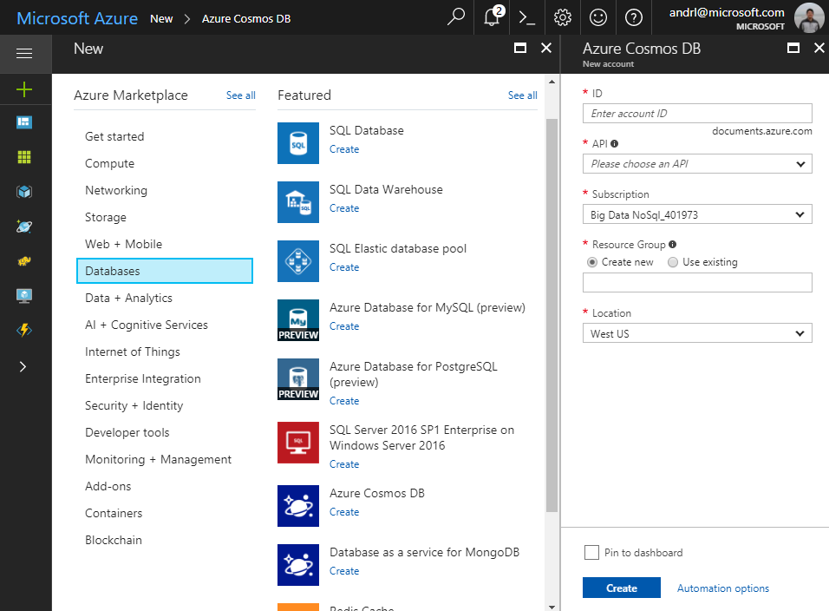
Creating Account
Account
Database
Database
Database
Database
Database
Container
Database
Database
Item

Slide 58
Database Representations
Account
Database
Database
Database
Database
Database
Database
Database
Container
Collection
Database
Database
Database
Database
Item
Document

Slide 59
Container Representations
Account
Database
Database
Database
Database
=
Database
Container
Collection
Graph
Table
Database
Database
Item

Slide 60
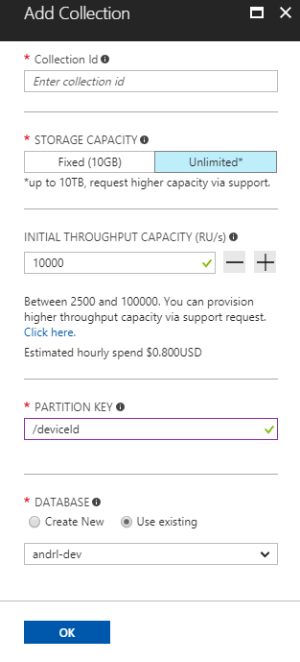
Creating Collections – SQL API
Account
Database
Database
Database
Database
Database
Container
Database
Database
Item

Slide 61
Container-Level Resources
Account
Database
Database
Database
Database
Database
Container
Database
Database
Sproc
Trigger
UDF
Conflict
Item

Slide 62
Modern Reactive Applications
IoT, gaming, retail and operational logging applications need to track and respond to tremendous amount of data being ingested, modified or removed from a globally-scaled database.
COMMON SCENARIOS
Trigger notification for new items
Perform real-time analytics on streamed data
Synchronize data with a cache, search engine or data warehouse.
Change feed
Notes:
Some common scenarios include:
Triggering a notification or a call to an API when a document is inserted or modified.
Stream processing for IoT or performing analytics.
Additional data movement by synchronizing with a cache, search engine, or data warehouse, or archiving data to cold storage.

Slide 63
Change Feed
Persistent log of records within an Azure Cosmos DB container. Preseneted in the order in which they were modified
New Events
Azure Cosmos DB
Change feed

Slide 64


Change Feed Scenarios
Event-Computing and Notifications
Retail, Gaming, Content management
Trigger a call to an API when a document is inserted or modified
Azure functions
Azure Notification Hubs
Azure App Service
Stream processing
IoT processing, Data science & analytics
Perform real-time (stream) processing on updates to data
New Events
Azure Stream Analytics
Azure Databricks
Apache Spark
Apache Storm
Azure Cosmos DB
Change feed
Data movement
Enterprise data management
Move, clone, or archive data to cold storage
Azure Storage Blob
Azure Data Lake
Azure Cosmos DB

Slide 65
Event Sourcing for Microservices
Trigger Action From Change Feed
Persistent Event Store
Microservice #1
New Event
Microservice #2
…
Azure Cosmos DB
Change feed
Microservice #N

Slide 66
Materializing Views
Application
Azure Cosmos DB
Materialized View
Subscription | User | Create Date | …
123abc | Ben6 | 6/17/17
456efg | Ben6 | 3/14/17
789hij | Jen4 | 8/1/16
012klm | Joe3 | 3/4/17
User | Total Subscriptions
Ben6 | 2
Jen4 | 1
Joe3 | 1
Change feed

Slide 67
Replicating Data
Secondary Datastore (e.g. archive)
Replicated Records
CRUD Data
Azure Cosmos DB
Change feed

Slide 68
Module 2 – Adding Cosmos DB data
Instructions at
https://github.com/CSA-OCP-GER/azure-serverless-bootcamp

Slide 69
Event based computing in Azure with Event Grid

Slide 70


Slide 72













Eventing in the cloud
Events
Event Handlers
Blob Storage
Serverless Code
Resource Groups
Functions
Azure Subscriptions
Event Grid
Serverless Workflow and Integration
Event Hubs
CloudEvents Format
Logic Apps
Azure Media Service
Buffering and
Competing Consumers
IoT Hub
Service Bus
Event Hubs
Storage
Queues
Custom Events (anything)
Other Services and Applications
CloudEvents Sources
Hybrid Connections
(WebSockets)
WebHooks (anything)
Azure Automation

Slide 73
Azure Event Grid
Fully-managed event routing
Near real-time event delivery at scale
Broad coverage within Azure and beyond
Backbone of event-driven computing

Slide 74
Benefits
Focus on innovation and pay per event
Ensure reliability and performance for your apps
Unlock new scenarios for your apps
Manage all events in one place

Slide 75
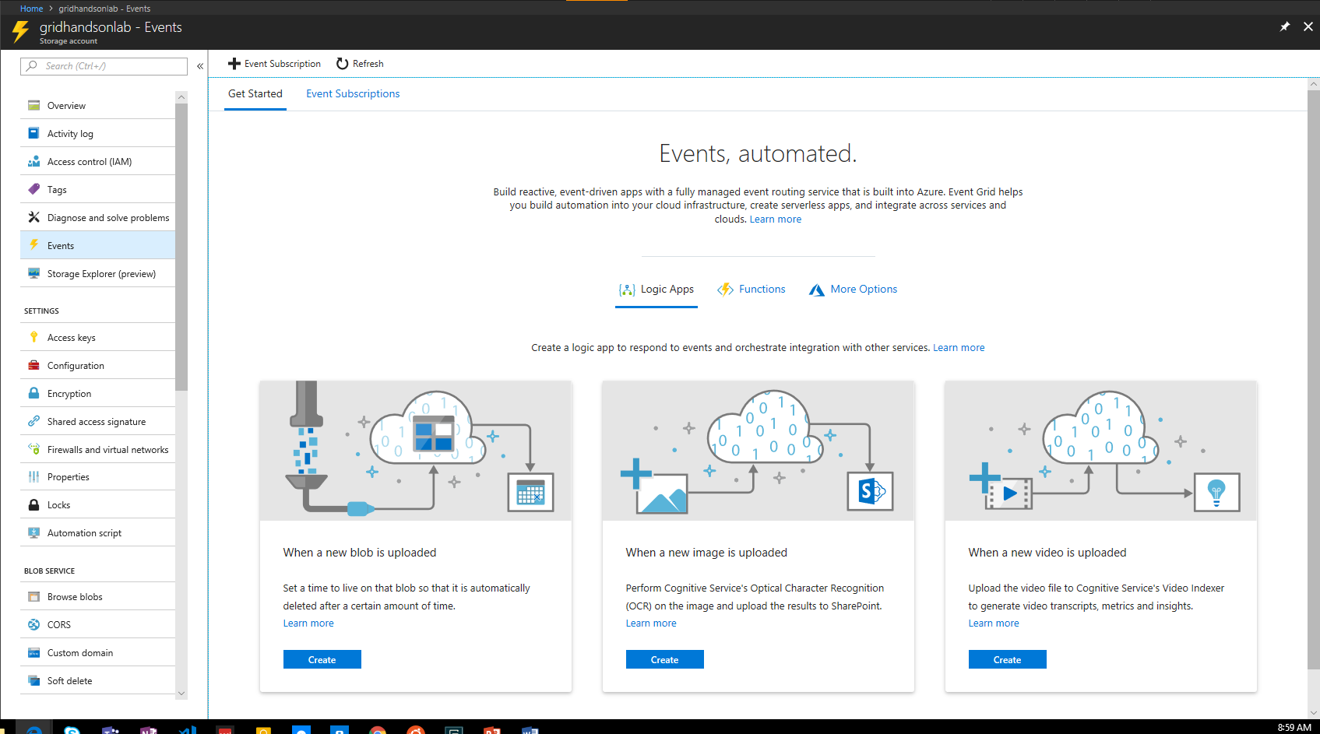
Manage all events in one place

Slide 76




Build applications efficiently
Management SDKs
Publish SDKs
Event Schema Store
Consumption SDKs
.Net Python Java Node.js Ruby Go

Slide 77
Ensure reliability and performance in your apps
SLA backed 99.99% availability
10,000,000 events per second per region
24-hour retry with exponential back off for events not delivered
High availability
Massive scale-out
High reliability

Slide 78
Benefit from broad coverage
Publishers
Subscribers
Coming Soon
Immediately available
Immediately available
Publishers
Azure Active Directory, API Management, Service Bus, Azure Data Lake Store, Cosmos DB, Azure Container Registry, Azure Security Center, Azure Media Services, KeyVault, Azure Container Instances, Azure Batch, Analytics
Blob Storage
Azure Functions
Resource Groups
Logic Apps
Azure Subscriptions
Azure Automation
Event Hubs
WebHooks
Subscribers
Service Bus, Azure Data Factory, Storage Queues, Azure Container Instances
Custom Events
Event Hubs
IoT Hub
General Purpose Storage v2
Service Bus

Slide 79
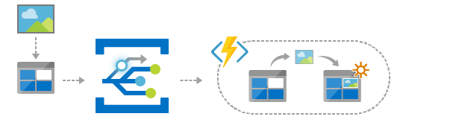
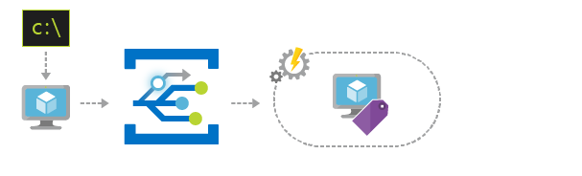
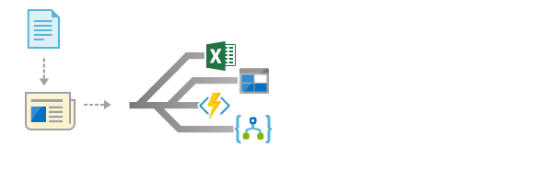
Scenarios
Serverless apps
Ops automation
Application integration
Instantly trigger a serverless function to run analysis when a new file is added to a blob storage container.
Speed up automation and simplify policy enforcement by notifying Azure Automation when underlying infrastructure is provisioned
Connects your app with other services. Create an application topic to route your app’s event data to any desired destination

Slide 80
Sample Event
[{
"topic": "/subscriptions/{subscription-id}/resourceGroups/Storage/providers/Microsoft.Storage/storageAccounts/xstoretestaccount“,
"subject": "/blobServices/default/containers/testcontainer/blobs/testfile.txt",
"eventType": "Microsoft.Storage.BlobCreated",
"eventTime": "2017-06-26T18:41:00.9584103Z",
"id": "831e1650-001e-001b-66ab-eeb76e069631",
"data": {
"api": "PutBlockList",
"clientRequestId": "6d79dbfb-0e37-4fc4-981f-442c9ca65760",
"requestId": "831e1650-001e-001b-66ab-eeb76e000000",
"eTag": "0x8D4BCC2E4835CD0",
"contentType": "text/plain",
"contentLength": 524288,
"blobType": "BlockBlob",
"url": "https://example.blob.core.windows.net/testcontainer/testfile.txt",
"sequencer": "00000000000004420000000000028963",
"storageDiagnostics": {
"batchId": "b68529f3-68cd-4744-baa4-3c0498ec19f0"
}
},
"dataVersion": "",
"metadataVersion": "1“
}]

Slide 81

Learn more at azure.com/EventGrid

Slide 82
Module 3 – Making the solution event-driven
Instructions at
https://github.com/CSA-OCP-GER/azure-serverless-bootcamp

Slide 83
Integration Made Easy with Logic Apps

Slide 84
The Internet
noun | ˈt͟hē in-ter-net
A technological universe made up by millions of different services, interconnected via APIs, that all look a little bit different from one to the other, and takes hours if not days to integrate with.

Slide 85
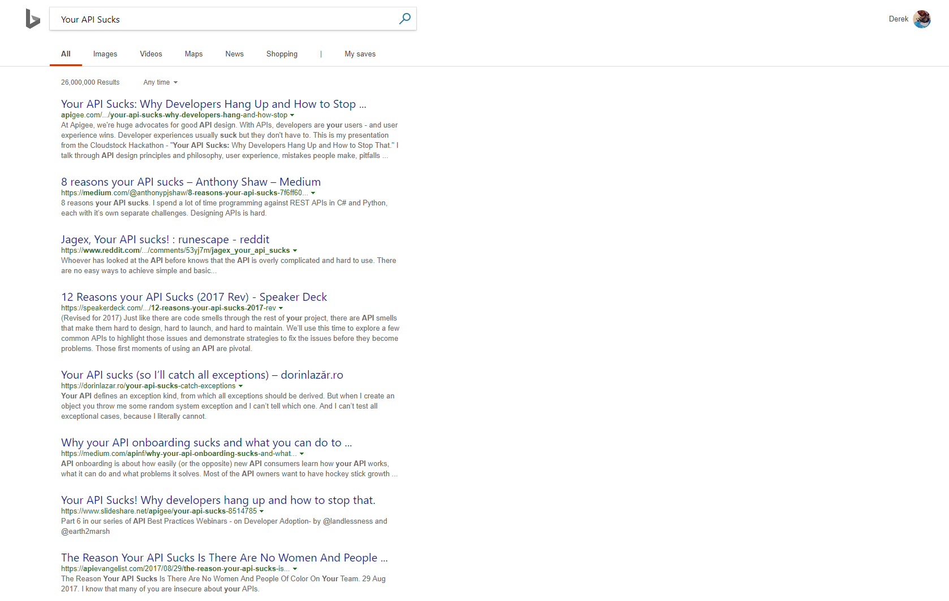

Slide 86




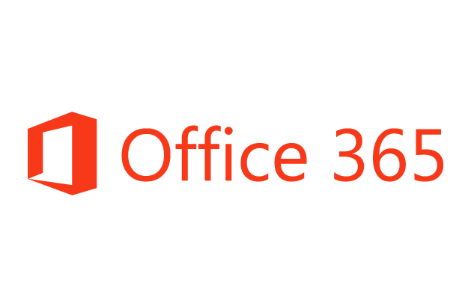


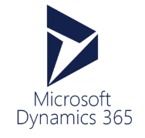






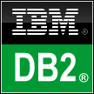



Azure Functions
Service Bus
Cognitive Services
Logic Apps
Machine Learning
Azure API Management
On-premises data gateway
BizTalk Server

Slide 87
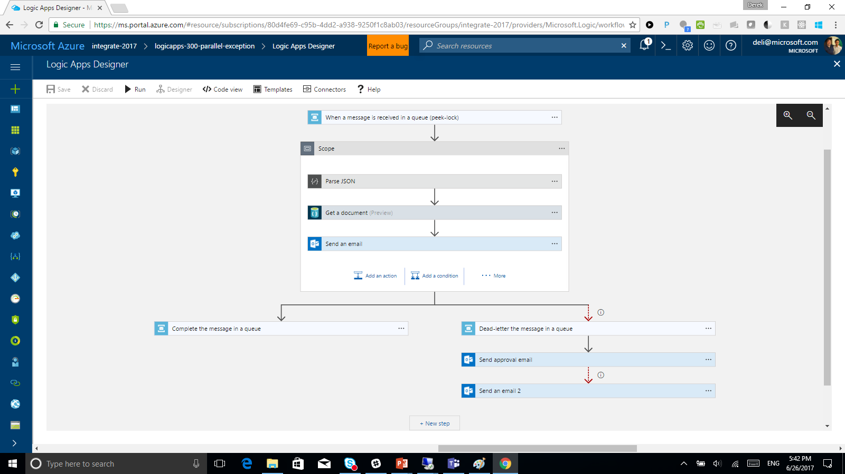

Slide 88
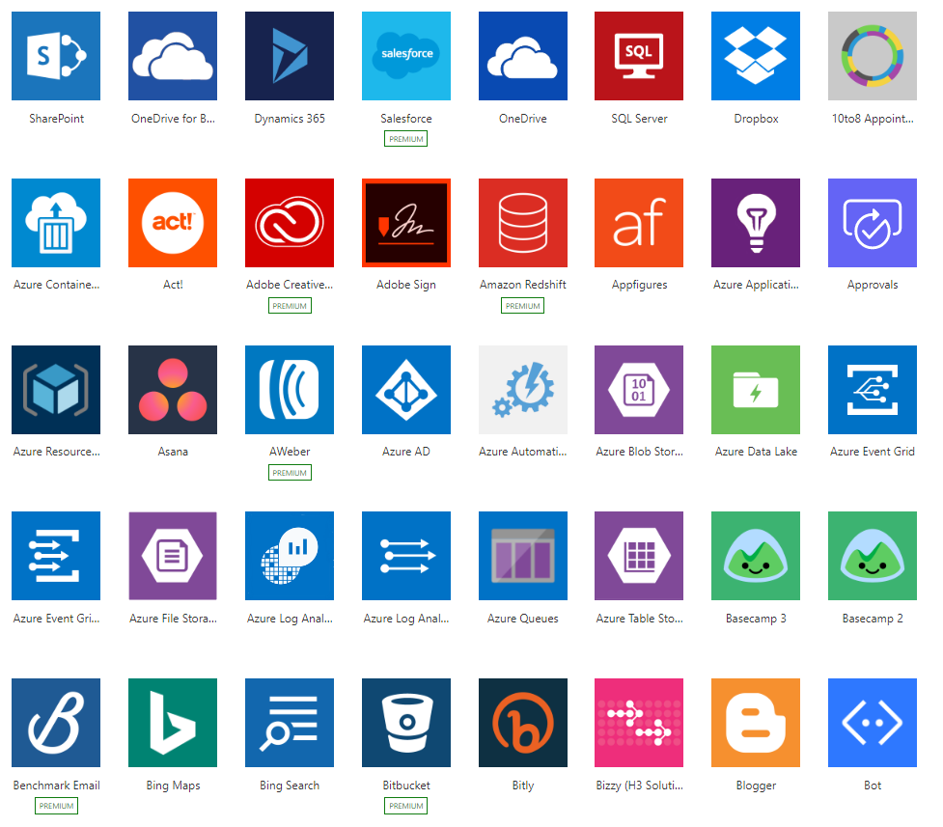
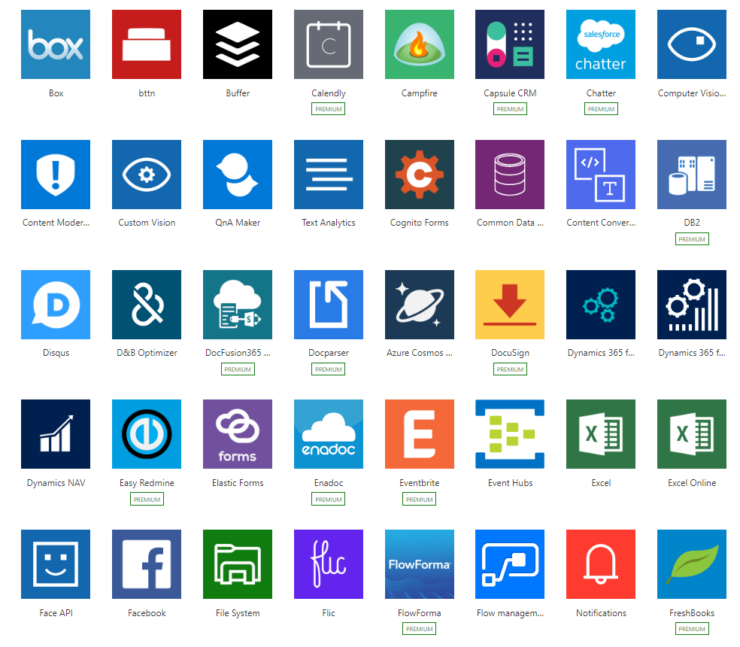
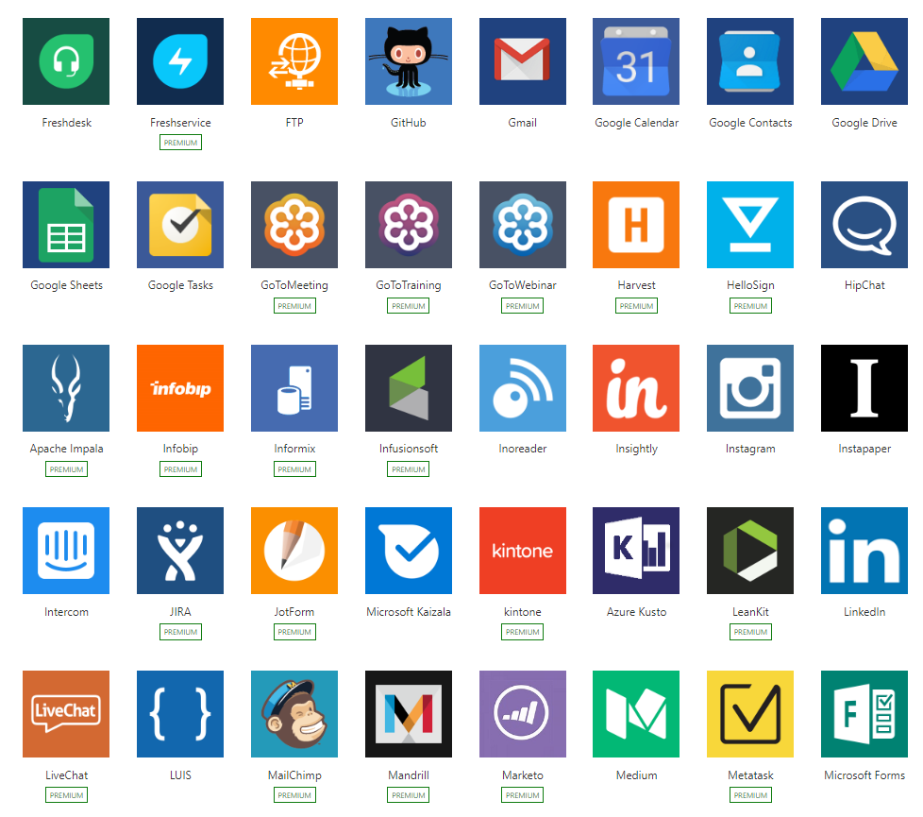
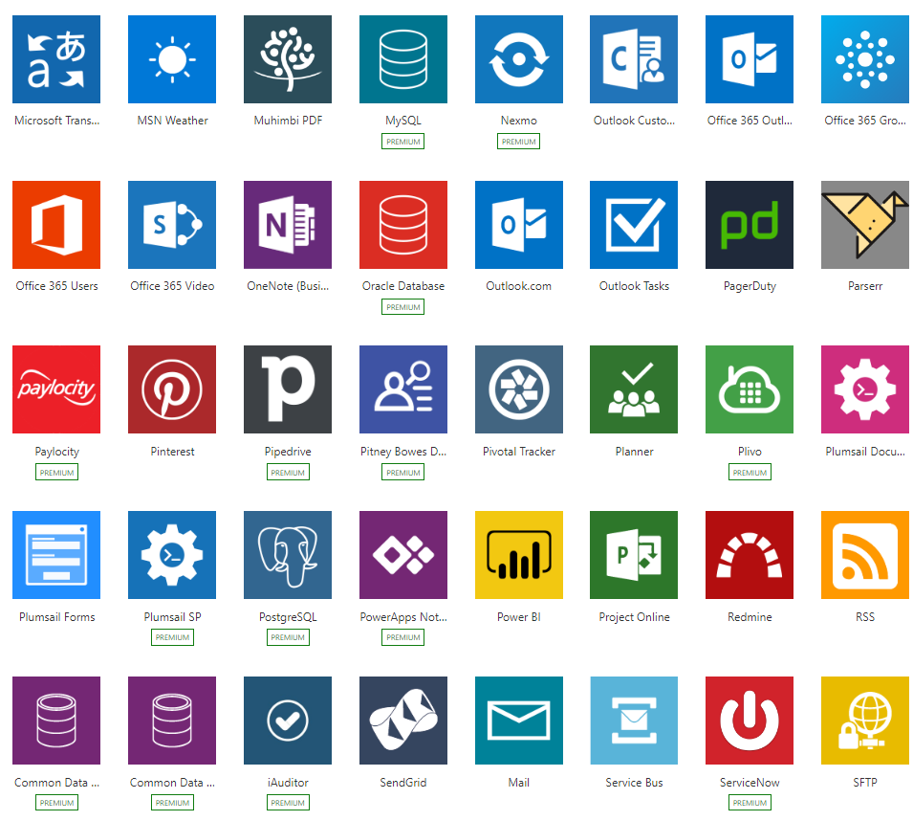
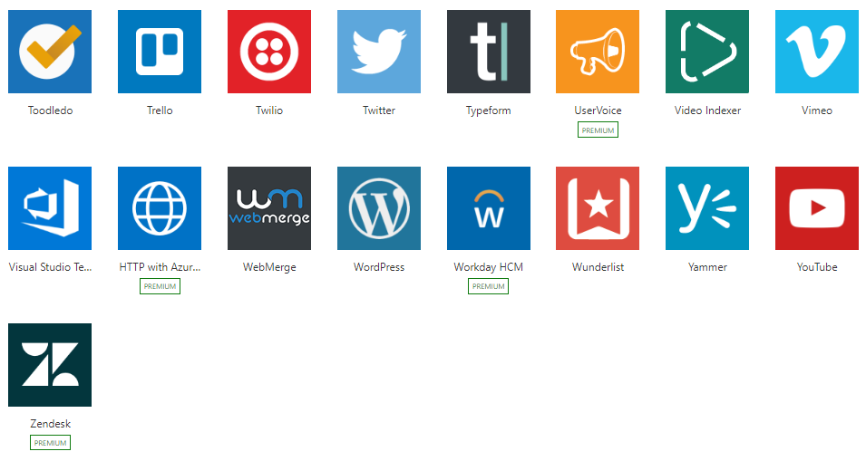
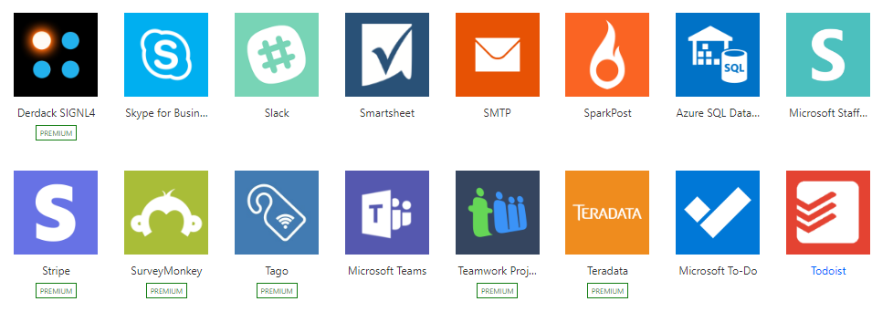
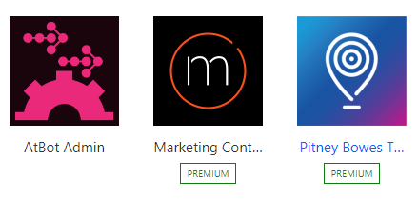
Connected
Built-in connectivity to 200+ SaaS cloud services, file providers, databases, web APIs, productivity apps, and more
Connect to on-premises systems via Data Gateway
Pluggable extensibility via Custom Connectors to integrate existing LOB systems into Logic Apps including SOAP support

Slide 89
Let’s have a look in to portal

Slide 90
Let’s talk about BFYOC

Slide 91
Customer Satisfaction Survey
Trigger by event from custom topic
Query CosmosDB for product data
Send out e-mail survey
Collect and store in CosmosDB

Slide 92
Module 4 – Orchestrating serverless workflows
Instructions at
https://github.com/CSA-OCP-GER/azure-serverless-bootcamp

Slide 93
Feedback

